Slide 1
Github

Slide 2
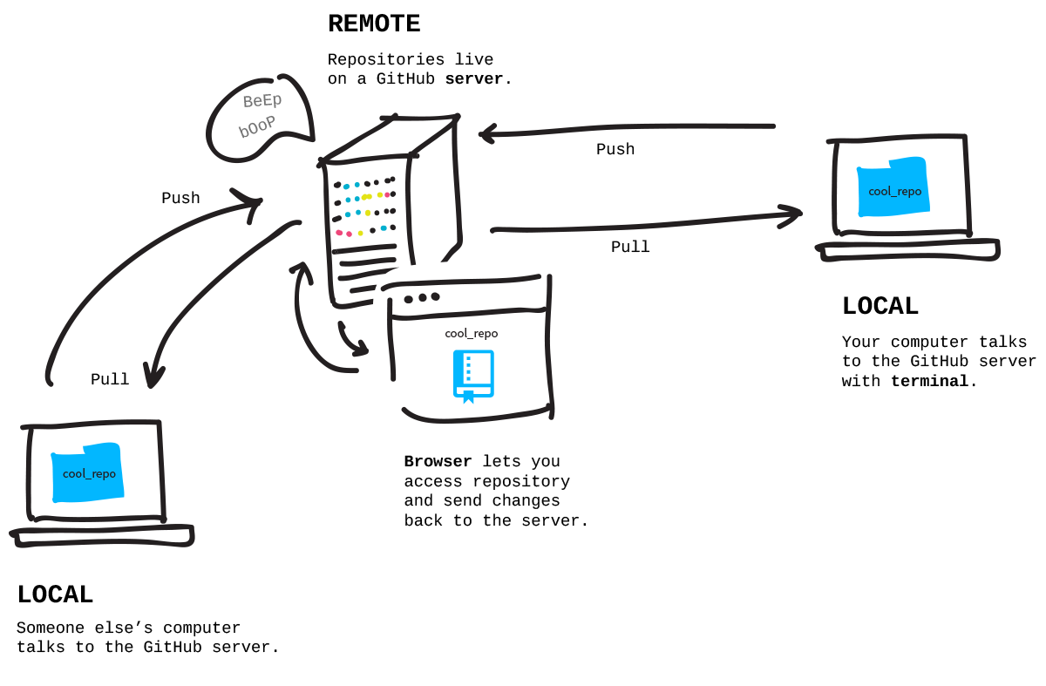
Github: version tracking
https://github.com/gerardhros/euosi

Slide 3
Requirements
Rstudio installed
Github installed; https://git-scm.com/download/win
Account registered by Github
Gitkraken installed; https://www.gitkraken.com/download

Slide 4
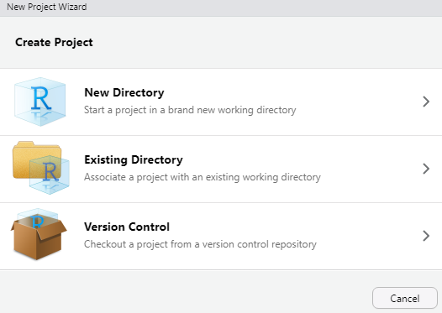
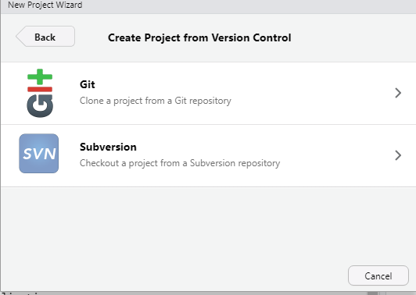
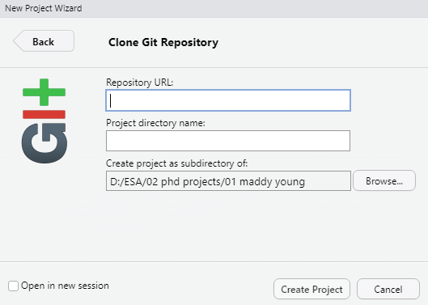
Add new project
Add online link by url
Select “version control”
Select “Git”
And update local directory where to store
https://github.com/gerardhros/euosi.git

Slide 5
Work flow
There is an online repo
There is a main branch (called “main”)and you can make an own branch
Branching lets you have different versions of a repository at one time.
By default, a repository has one branch named main that is considered to be the definitive branch. You can create additional branches off of main in your repository. You can use branches to have different versions of a project at one time. This is helpful when you want to add new features to a project without changing the main source of code. The work done on different branches will not show up on the main branch until you merge it. You can use branches to experiment and make edits before committing them to main.
When you create a branch off the main branch, you're making a copy, or snapshot, of main as it was at that point in time. If someone else made changes to the main branch while you were working on your branch, you could pull in those updates.

Slide 6
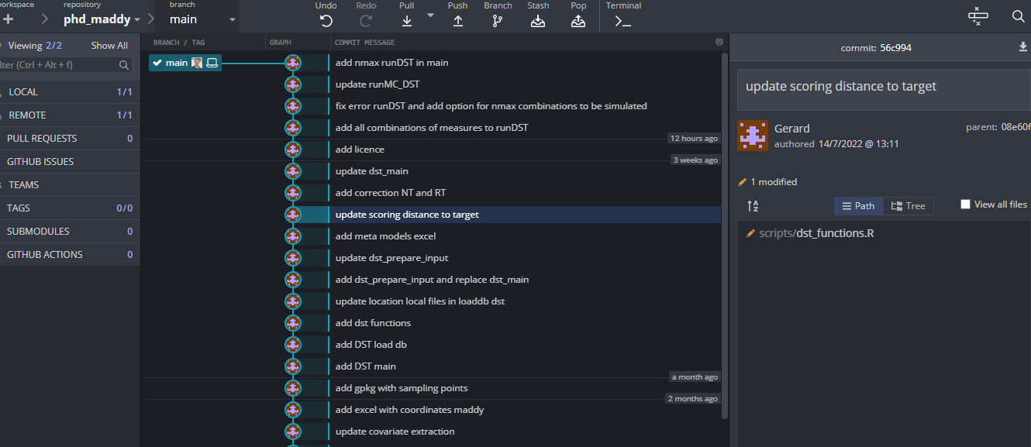
I use gitgraken given nice interface

Slide 7
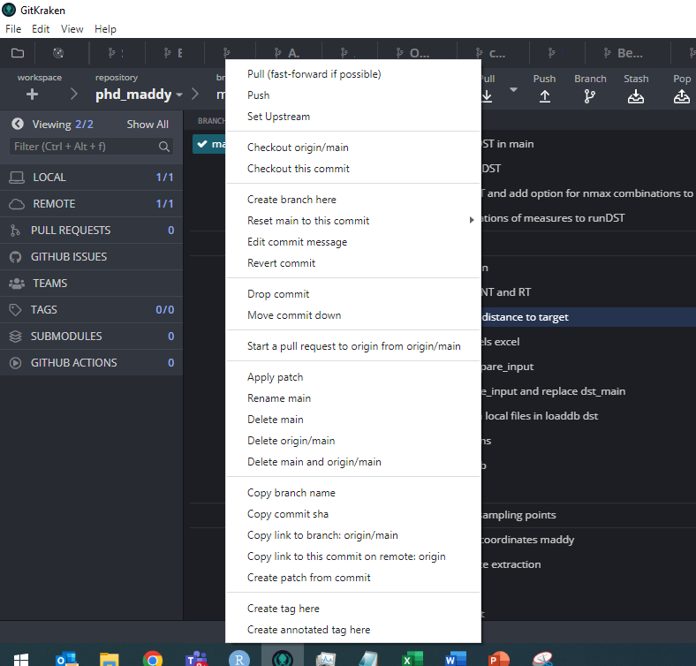
Add new branche
Rightclick on “main”
Select “create branch” and add a new (you add short code)
Usually you make branches for relative small contributions (so, not for more than 100 commits), so make a branch for a specific task / improvement. Can range from 10 to 50 commits at maximum I would suggest.

Slide 8
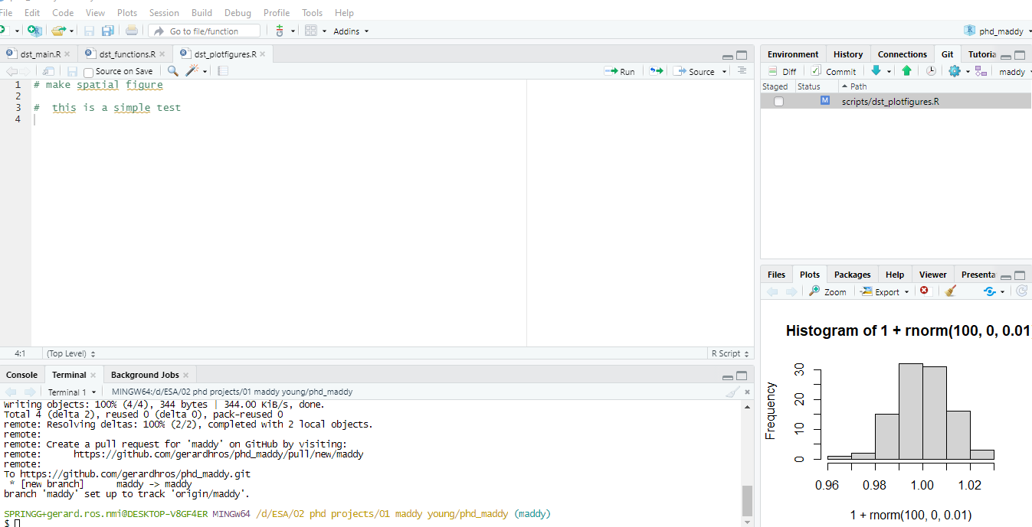
Workflow in R
Here you can switch brances
All files that are changed by you are visible here
In this terminal you “communicate with git”

Slide 9
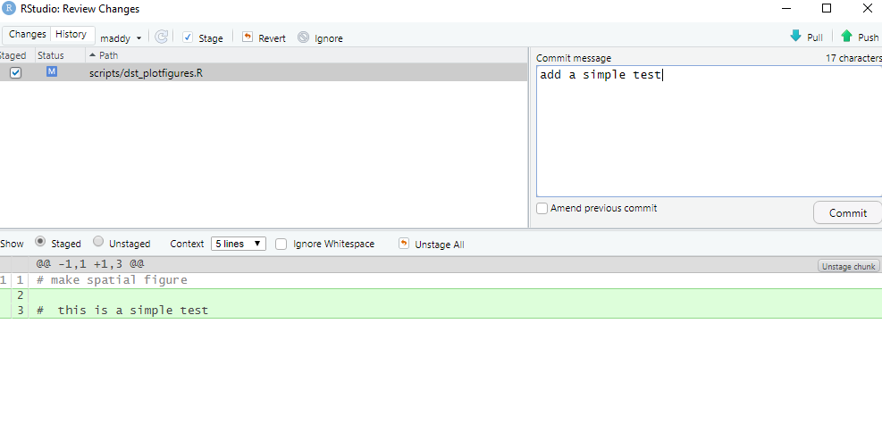
Workflow in R
If you have changed a file, add “commit” (to local)
Give a short description of the change by “commit message”
Press commit
Now changes are stored local in git
When pressing “push” the changes are also updated in remote git
Always first “pull” before pressing “push”. If someone else has made changes in your branch, then you download these changes first before adding your own ones. Sometimes that might result in a conflict. Then it gives a warning.
In gitkraken, there is then a nice overview showing the conflicts (side-by-side screen) and you can select which rows / files you want to save and which one you want to ignore

Slide 10
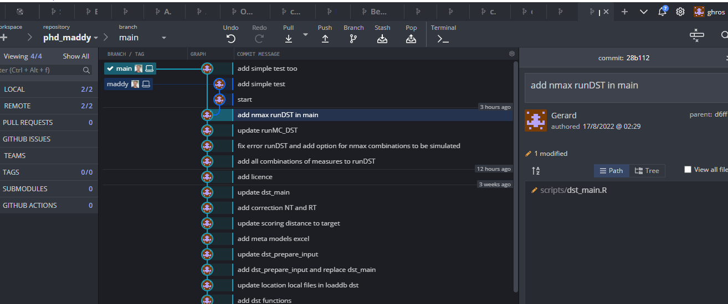
Here example of first test

Slide 11
When needed, your branch can be merged into main
Quickest way is
Go to github.com, select your repo
Select “pull request”
Press “new pull request”
Select the branch that you want to merge into main
Press “create pull request”
And request a review (from me in this case) by pressing button for add reviewer

